Slide 1

MEDLANCE
Health At Your Fingertips

Slide 2
PROJECT OVERVIEW
The Product:
Medlance is an easy to use application which provides two services to the user, firstly it allows you to connect to the nearest ambulance along with real-time tracking of the vehicle and secondly it will provide an interface where you can enter the name of the medicine and it will help you find the nearest medical store which has the said medicines available.

Slide 3
PROJECT OVERVIEW
The Problem
The Goal
As we have seen during the recent global pandemic there were cases in which many pharmacies ran out of medicines due to which the customers had to run from store-to-store to find the medicines. We needed a service that can guide us to the right and nearest medical store.
Also, on an average it takes 20-30 minutes for an ambulance to reach the patient. We need a service that will connect us to the nearest ambulance so that the ETA can be reduced.
Design and develop an easy to use application that can not only be used to connect us to the nearest ambulance with just a few clicks, but also provides a service that allows you to send request to the nearest medical store that has your medicines available.

Slide 4
01
02
03
COMPANY
TARGET
SERVICES
Easing the user experience for booking ambulances and checking medicine availability
Find and Book nearest ambulance.
Check medicine availability.
First Aid Guide.
Online consultancy with doctors.
Medlance

Slide 5
“You don’t have to be a doctor to save lives.”

Slide 6
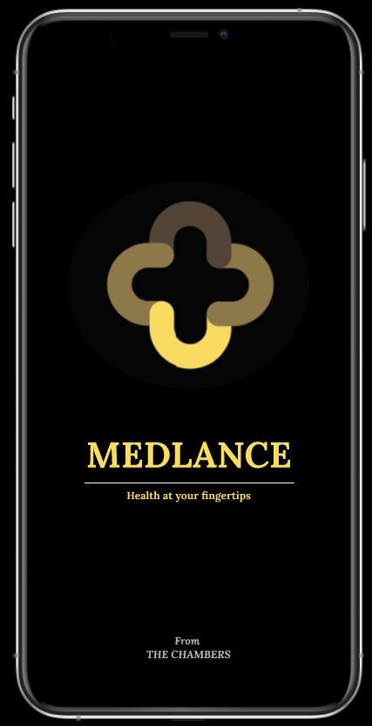
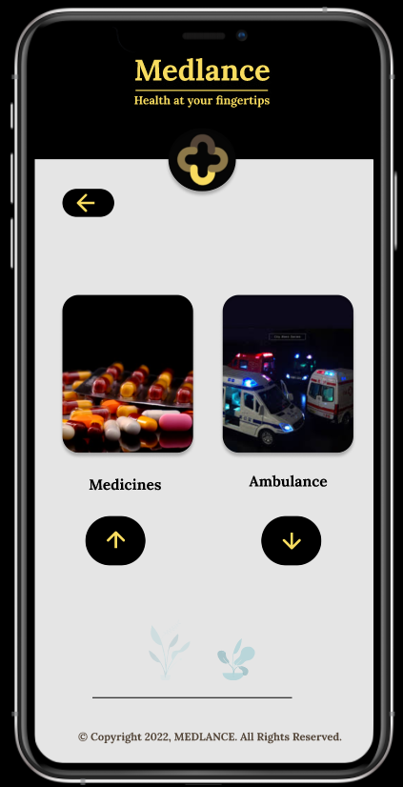
Preview of our Prototype
Click to open project prototype

Slide 7
THANKS!
A Team effort by : Team Medlance

